Slide 1

ANIMAL DETECTION SYSTEM
ADINA INSTITUTE OF SCIENCE & TECHNOLOGY SAGAR
Team Members :
Anuj Kurmi
Gourav Kurmi
Deeksha Sahu
Ragini Patel
Project Guide -
Mr. Anurag Jain
Asst. Professor

Slide 2
TABEL OF CONTENT
INTRODUCTION
WORKING
BENEFITS
TECHNOLOGIES
PYTHON
APPLICATIONS
ADVANTAGES
FUTURE DIRECTION
UI OF THE PROJECT
CONCLUSION
REFERENCE

Slide 3
INTRODUCTION
The Animal Recognition System is a cutting-edge technology that utilizes machine learning and computer vision to identify and classify animal species in images and videos. This system has numerous applications in wildlife conservation, research, and education, providing a powerful tool for understanding and protecting our planet's diverse wildlife.A system that can identify animals using cameras and software.
It uses AI (Artificial Intelligence) to recognize animals

Slide 4
Technologies Used
Image:Uplode a clear image .
Web Browser: User interface.
Machine Learning Model: Detects animals.
Python/JavaScript: Programming languages.
Flask / Django: Web frameworks.

Slide 5

Python
Python – Main programming language used.
Libraries Used:
  OpenCV – For image and video processing.
  TensorFlow / PyTorch – For training and running AI models.
  Flask / Django – For building the web application.
Machine Learning – Used to train the system to detect different animals.
Image Classification – Python helps recognize animals in photos or video.
Automation – Python scripts run the detection and send alerts.
Integration – Easily connects to web front-end and databases.

Slide 6



Technology
HTML (HyperText Markup Language)
Builds the structure of the website.
Creates pages to upload images or show results.
CSS (Cascading Style Sheets)
Adds style and layout to the web pages.
Makes the interface clean, responsive, and user-friendly
JavaScript
Adds interactivity (like live updates or alert messages).
Sends and receives data from the Python backend.
Displays detection results without refreshing the page.

Slide 7
How Does It Work
Image or Video Input: The system accepts images or videos as input, which can be obtained from various sources such as camera traps, drones, or smartphones.
2. Pre-processing: The input data is pre-processed to enhance quality, remove noise, and prepare it for analysis.
3. Machine Learning Model: A pre-trained machine learning model, such as MobileNet, is used to analyze the input data and identify the animal species.
4. Classification: The system classifies the animal species based on the features extracted from the input data.

Slide 8
Benefits
Accurate Identification: The system provides accurate identification of animal species, reducing the risk of human error.
2. Efficient Analysis: The system can analyze large datasets quickly and efficiently, saving time and resources.
3. Conservation Efforts: The system can aid conservation efforts by monitoring animal populations, tracking species distribution, and identifying areas of high conservation value.

Slide 9
Potential Applications:
1. Wildlife Conservation: Monitoring animal populations, tracking species distribution, and identifying areas of high conservation value.2. Research: Analyzing camera trap images, studying animal behavior, and gaining insights into ecosystem dynamics.3. Education: Teaching students about different animal species and promoting awareness about wildlife conservation.

Slide 10
Advantages
Real-Time Detection – Instantly finds animals using live video.
Remote Access – Works from anywhere through a web browser.
Automation – No need for manual monitoring.
Safety – Helps avoid animal-human accidents.
Scalability – Can be used in forests, farms, or cities.
Data Logging – Stores images and results for future analysis.
Eco-Friendly – Non-invasive monitoring of wildlife.

Slide 11
Future Directions
1. Object Detection: Integrating object detection capabilities to identify multiple animals in a single image or video.2. Species Classification: Expanding the system to recognize more animal species and provide detailed information about each species.

Slide 12
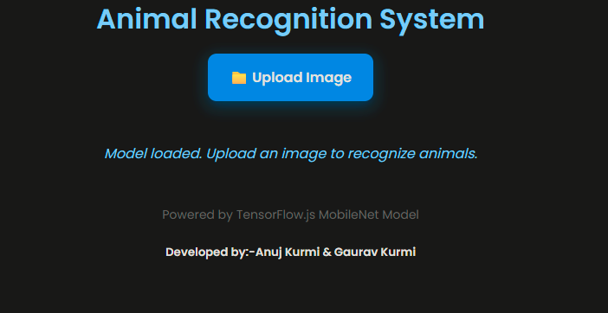
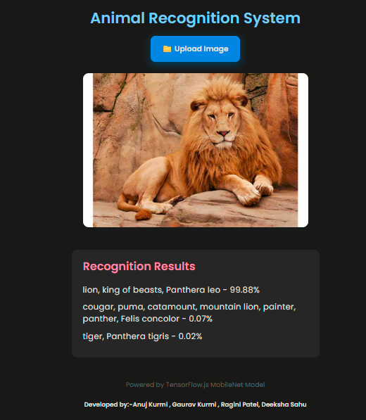
UI of the project with result

Slide 13

Web-based animal detection systems are helpful tools.
They combine AI and the internet to solve real-world problems.
Can be used in many useful ways to protect animals.
Smart Systems
Animal Detection
Web-Based Monitoring
Summary of findings, implications of the project, and suggestions for future work, including potential improvements and expansions of the system

Slide 14


REFERENCE
Visual Studio Code (VS Code)
Used as the main code editor for writing and testing Python and ML code.
ChatGPT
Used to generate explanations, debug code, and understand ML concepts.
Git
Used for tracking changes in the project code.
GitHub
Used to store, share, and collaborate on the code online.

Slide 15
